Slide 1
Our New Y7 Approach
2017-2018
Notes:
This presentation is designed as a starting point, to be adapted to your own school context.

Slide 4
Do the maths – true or false?
Even + Even = Even
Even + Odd = Even
Odd + Odd = Even
Can you explain why?
Can you prove why…
Using algebra?
Without using algebra?
Notes:
Here’s an example Mathematics Mastery activity for you to try – are these results sometimes, always or never true? Can you prove your results?
(You may like to provide multi-link here!)

Slide 5
Our approach
Conceptual understanding
Mathematical
problem
solving
Mathematical thinking
Language and communication
Notes:
These are the four cornerstones of the Mathematics Mastery approach – problem solving at the heart with emphasis on developing students’ conceptual understanding to ensure procedural fluency, deepening mathematical thinking and with consistent focus on correct mathematical language and good communication of solutions.

Slide 6
NC 2014
“Decisions about progression should be based on the security of pupils’ understanding and their readiness to progress to the next stage. Pupils who grasp concepts rapidly should be challenged through being offered rich and sophisticated problems before any acceleration through new content in preparation for key stage 4. Those who are not sufficiently fluent should consolidate their understanding, including through additional practice, before moving on”
Notes:
This quote comes from the 2014 National Curriculum – it explicitly aims for mastery for all rather than rushing a small proportion through more and more content.

Slide 7
Curricular principles
Fewer topics in greater depth
Mastery for all pupils
Number sense and place value come first
Problem solving is central
Notes:
In line with 2014 National Curriculum, there is no “racing ahead”
Opportunities are provided throughout Mathematics Mastery for pupils to use reasoning skills to make connections between prior knowledge and newly presented material. These connections will help foster a deeper understanding of the maths concepts.
There is a huge emphasis in the early months on ensuring number rules are learned and understood so they can be called upon relaibly when studying other areas of mathematics.
Traditional algorithms are meaningfully taught so that comprehension, calculation and problem solving developed simultaneously.

Slide 8
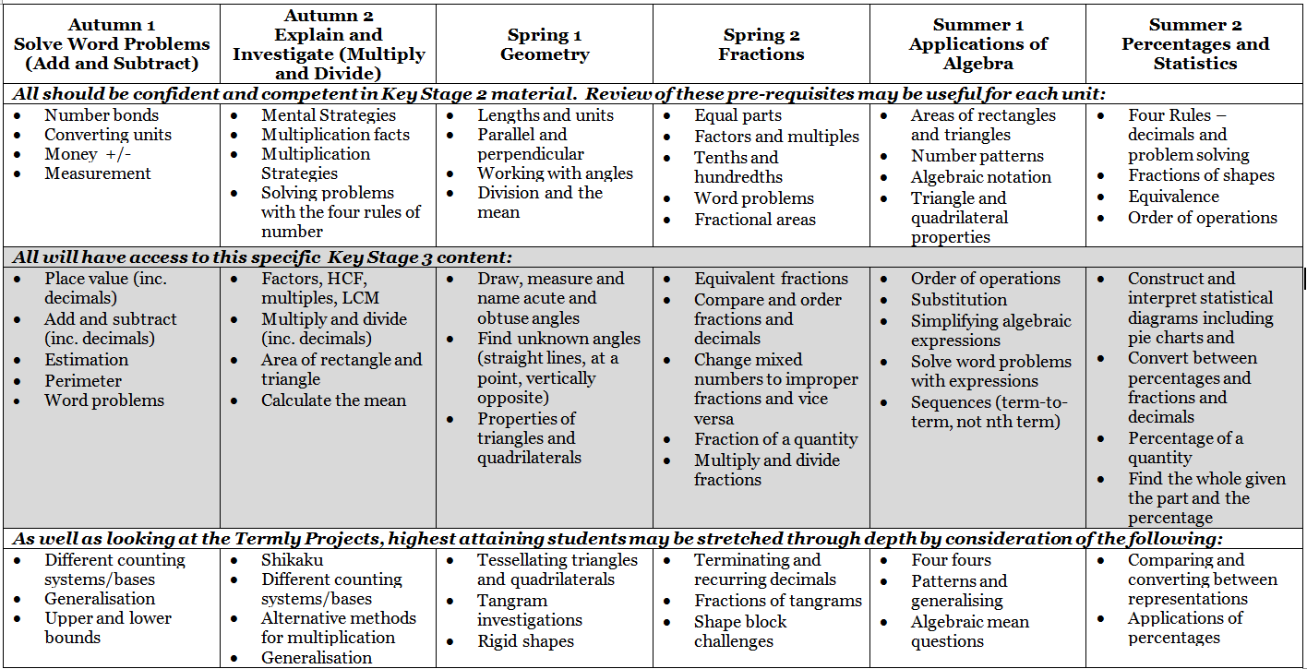
Y7 differentiation through depth
Notes:
Following the Mathematics Mastery curriculum in Year 7, ALL students will study the material highlighted on the middle row. Coaching material will be provided to support lower attainers as will suggested tasks to support higher attainers to cover the same material in greater depth – not “extra maths” but challenging work in the same content area.

Slide 9
Mathematics Mastery key principles
Conceptual understanding
Pupils deepen their understanding by representing concepts using objects and pictures, making connections between different representations and thinking about what different representations stress and ignore.
Mathematical thinking
Pupils deepen their understanding by giving an examples, by sorting or comparing, or by looking for patterns and rules in the representations they are exploring problems with.
Conceptual understanding
Mathematical problem solving
Mathematical thinking
Language and communication
Language and communication
Pupils deepen their understanding by explaining, creating problems, justifying and proving using mathematical language. This acts as a scaffold for their thinking deepening their understanding further.
Notes:
All this ties in with the key cornerstones of the Mathematics Mastery approach, with problem-solving at the heart. Next we are going to discuss conceptual understanding

Slide 10
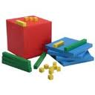
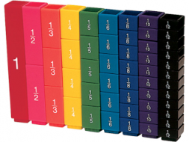
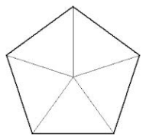
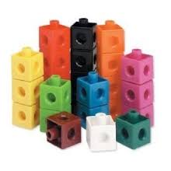
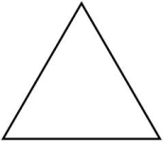
What are manipulatives?
Bead strings
Bar models
Dienes blocks
100 grids
Conceptual understanding
Fraction towers
Number lines
Cuisenaire rods
Mathematical
problem
solving
Shapes
Multilink cubes
Mathematical thinking
Language and communication
Notes:
These are some examples of materials that can be used at the “concrete” and “pictorial” stages to support students at all levels of attainment to access mathematics and deepen their understanding

Slide 11
Problem solving – a pictorial approach
Abe, Ben and Ceri scored a total of 4,665 points playing a computer game.
Ben scored 311 points fewer than Abe. Ben scored 3 times as many points as Ceri.
How many points did Ceri score?
Ceri
4, 354
4,665
Ben
Abe
311
4,665 – 311 = 4,354
4, 354 ÷ 7 = 622
Ceri scored 622
Check: 622 + 1,866 + 2, 177 = 4,665
Notes:
Talk through this problem, demonstrating the bar model method, explaining how it could be linked to algebraic notation in time and would help students to understand what is meant by “x”

Slide 12
Do the maths!
Jake is 3 years older than Lucy and 2 years younger than Pete.
The total of their ages is 41 years old.
Find Jake’s age.
What else can you find?
Notes:
Ask the audience to try this one themselves, using “bar models”

Slide 13
Problem solving
3 years
Lucy
?
2 years
Jake
?
33 years
41 years
39 years
Pete
?
41 – 8 = 33
33/3 = 11
? = 11 years
Jake is 11 + 3 = 14 years
Lucy is 11 years
Pete is 11 + 5 = 16 years
Notes:
Co through the solution – explain students get to practice a lot of easier ones when learning this method!!

Slide 14
Mastering mathematical thinking
“Mathematics can be terrific fun; knowing that you can enjoy it is psychologically and intellectually empowering.” (Watson, 2006)
We believe that pupils should:
explore, wonder, question and conjecture
compare, classify, sort
experiment, play with possibilities, modify an aspect and see what happens
make theories and predictions and act purposefully to see what happens, generalise
Notes:
This also ties in with another cornerstone, mathematical thinking. Lessons have a variety of these elements to build in and pre-empt misconceptions in panning to unpick learning and understanding.
Learning is generalisation. We want children to think like mathematicians. Not just DO maths…

Slide 15
Fractions – a “talk task”
Notes:
To support the development of language, Mathematics Mastery lessons all include “talk tasks”. These are also designed to again develop mathematical thinking and conceptual understanding at the same time – discussing and doing the maths together helps with this

Slide 16
Challenging high attainers
What number is 70 hundreds, 35 tens and 76 ones?
Which is bigger, 201 hundreds or 21 thousands?
How many bags each containing £10 000 do you need to have £3 billion?
How many ways can you find to show/prove your answers?
Notes:
Some people find it hard to see how we can challenge students who have already been successful in mathematics whilst studying the same area/content as those who need to “catch up”. This slide gives some examples of questions that, although they are about place value which is the fundamental building block of mathematics, are thought provoking and challenging. One of the key aims of Mathematics Mastery is to enable students to see things in a variety of different ways, so the last question is also key here – as well as providing challenge through the first three questions being phrased in a possibly unfamiliar manner, there is also the challenge of explaining and proving using a variety of representations. This helps both to deepen understanding and set students up for facing more and more complex and unfamiliar problems as they progress through the curriculum.

Slide 17
True or False?
A B C D E I
D E F G H C
G H I A B F
=
A B C B A C
D E F E F D
G H I I G H
=
Can you make your own true or false statements like these?
Notes:
This is another example of a challenging task from just the second week of Year 7. (Perhaps give some time for the parents to try this) After a little thought, it is reasonably easy to see that the top pair of sums will have the same answer whatever the values of A, B, C etc. In the second pair however, examples this would be true if all the letters have the same numerical value, but usually won’t be. It’s a really challenging question to come up with sets of values for which the sums will and won’t be equal. Even though we’re not expecting formal algebraic solutions (remember that comes later), we are encouraging students to explore and to start to make general statements so they’re ready for algebra when they do meet it.
Throughout the year, we will be challenging all pupils to show their understanding through questions like:
Is that the only answer?
Can you prove it?
What can we ask next?
From the highest attainers, we will be expecting great things, again challenging them to think mathematically as well as do the mathematical procedures so they can meet the demands of new, more demanding, GCSE and A level they will sit.

Slide 18
What would OfSTED think?
Evidence from successful schools:
Pupil collaboration and discussion of work
Mixture of group tasks, exploratory activities and independent tasks
Focus on concepts, not on teaching rules
All pupils tackled a wide variety of problems
Use of hands on resources and visual images
Consistent approaches and use of visual images and models
Importance of good teacher subject-knowledge and subject-specific skills
Collaborative discussion of tasks amongst teachers
Notes:
Every few years, OfSTED produce a report on what works in the mathematics classroom. These features are from the most recent report and you will see that the ideas from the Mathematics Mastery approach feature heavily. We’re really excited to be part of the partnership and are looking forward to working together as a team and with our partner schools to keep improving mathematics here at ______!

